Slide 1
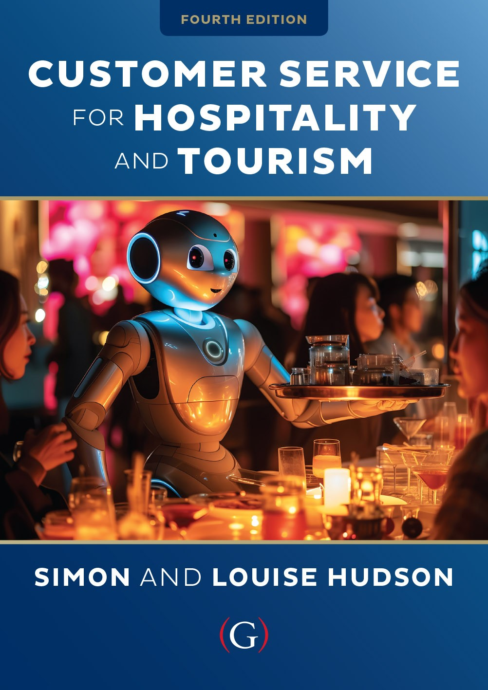
Chapter 2
The financial and behavioral impacts of customer service

Slide 2
Topics covered
  Relative importance of the service economy
  Impact of service quality on market share, price and profits
  Behavioral consequences of customer service
  Service profit chain
  Offensive and defensive marketing effects of service
  The financial implications of poor customer service

Slide 3

‘At Your Service’ Spotlight:
Scott Dunn Travel
‘If you’re part of the DNA of the company, you understand the importance of the guest,’ Andrew Dunn.
British luxury travel company established a benchmark for Alpine chalet holidays
70% repeat business through loyalty and referral
Differentiated on opulence and personal, high quality service
  Unexpected acts of kindness (U.A.K.s)
Undersells, over-delivers

Slide 4
Service quality
….customers’ perceptions of the service component of a product, and these perceptions are said to be based on five dimensions: reliability, assurance, empathy, responsiveness, and tangibles
Evaluation of purchase, determine satisfaction and likelihood of repurchase
Key factor in differentiating service products and building competitive advantage
Impacts profits and other financial outcomes of the organization
“Quality is far and away the chief factor in competitiveness” (Sharp, 2009: 91).
Since the COVID-19 pandemic, customer expectations have been higher than ever

Slide 5
Relative importance of the service economy
Shift from manufacturing to a focus on customer service
  Quality service increasingly critical to success
Services sector employment
  45 % of the world’s total labor force
Share in total economic activity increasing over time
  Western countries, accounts for over 80% of GDP
Rising trend expected to continue
  Reflects higher consumer and business demand
  Outsourcing of service-related activities
  Information technology

Slide 6
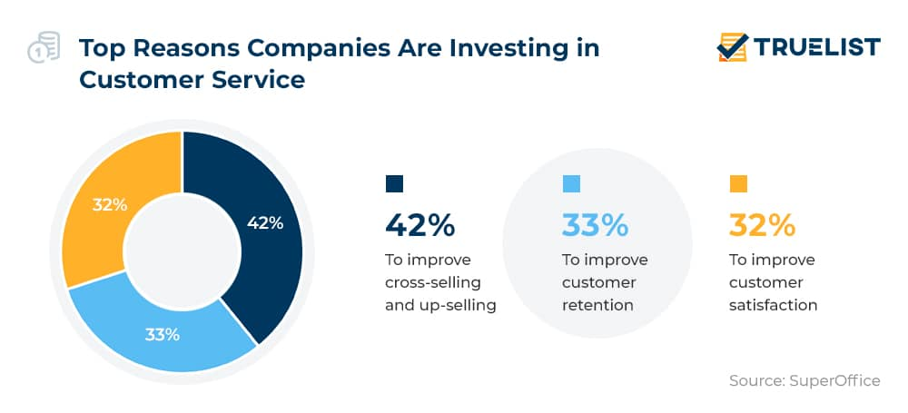
The impact of service quality on market share, price and profits
Service quality is crucial for:
  Differentiating service products
  Winning and retaining customers
  Building a competitive advantage

Slide 7
Satisfaction measure

Slide 8
High service quality means higher prices, profits and market share
  Premium prices
  ~8 % higher price than competitors (Gale, 1992)
  Retaining 5 % of customers
  Increase profits by 25% - 85 %
    Higher-than-normal market share growth

Slide 9
Snapshot:
Jonathan Tisch, Loews Hotels & Resorts
‘The Power of We’ - success cannot be achieved individually
Professional philosophy
  Building relationships with colleagues
  Empowering employees
  Collaborating with competitors
Customer outreach
  Beyond advertising campaigns
  “Buzz” and word-of-mouth marketing
  Creates customer experiences
Good Neighbor Policy
  Comprehensive outreach program
  Links business with communities
  Advocates social responsibility
  “At the heart of hospitality is the notion of making people feel comfortable, making people feel welcome and keeping them safe and secure”

Slide 10
The behavioral consequences of customer service
Positive behavioral intention indicators
  Saying positive things
  Recommending company or service
  Paying a premium
  Demonstrating loyalty
Negative behavioral intention
  Complaining
  Spending less money
  Signaling poised to leave the company

Slide 11
Behavioral and financial consequences of service quality

Slide 12
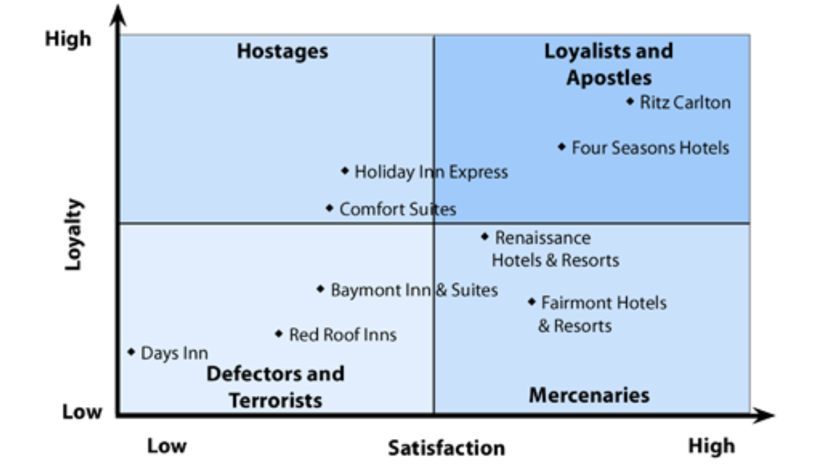
The Apostle Model

Slide 13
The service profit chain
Employee satisfaction, loyalty
  Internal service quality
  Employee productivity
Customer satisfaction, loyalty
  Value of services provided to the customer
  Customer retention
Lifetime value of a customer (CLV)
  Financial value of long-term relationships
  Potential lifetime revenue
    Average lifespan
    Sales of additional products and services
    Referrals
The CLV for an average Starbucks customer is over $14,000, and for Ritz-Carlton it is an impressive $250,000

Slide 14
The service profit chain

Slide 15
Offensive and defensive marketing
Offensive marketing
  Attract more, better customers
  Improve reputation
    Higher market share
    Price premiums
Defensive marketing
Retain existing customers
Longtime customer more profitable
Lower costs
Attracting a new customer five times more costly

Slide 16
Offensive and defensive marketing effects of service

Slide 17
Financial implications of poor customer service
More than half of consumers reduce or stop spending with a brand after a negative customer experience (see next slide)
Businesses are forced to spend more on customer acquisition, trying to replace losses in their customer base
Some customers that defect after poor service can turn into what are called ‘terrorists,’ who are desperate to tell others about their unhappy experiences
With the advent of social media, customer service terrorists can vent their anger in less expensive ways, and still reach a very wide audience

Slide 18
How customers change their spending after poor experiences across industries

Slide 19
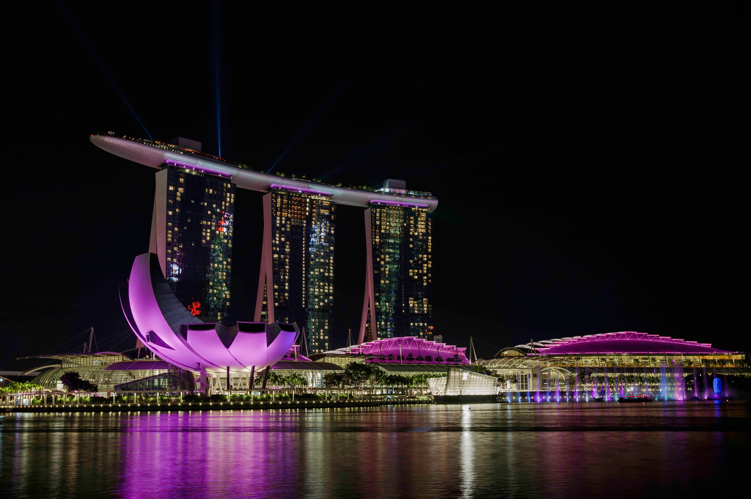
Case study: Marina Bay Sands, Singapore
The Marina Bay Sands (MBS) is an integrated resort that includes a luxury hotel with over 2,200 rooms, a shopping mall featuring high-end brands, celebrity chef restaurants, theaters, and convention spaces.
The resort annually attracts about 45 million visitors
The development of MBS has had a significant economic impact on Singapore
The casino itself takes up 15,000-square-metres of space in the resort, and features about 500 gaming tables, 1,600 slot machines (locals call them ‘jackpot machines’) as well as more than 30 private gaming rooms.
In the casino’s own words “Marina Bay Sands offers a vast selection of the newest and most popular electronic gaming machines worldwide. Their collection of machines features more than 250 themes and game titles to choose from”

